Slide 1
ZigBee/IEEE 802.15.4

Slide 2
By.
P. Victer Paul
Dear,
We planned to share our eBooks and project/seminar contents for free to all needed friends like u.. To get to know about more free computerscience ebooks and technology advancements in computer science. Please visit....
http://free-computerscience-ebooks.blogspot.com/
http://recent-computer-technology.blogspot.com/
http://computertechnologiesebooks.blogspot.com/
Please to keep provide many eBooks and technology news for FREE. Encourage us by Clicking on the advertisement in these Blog.

Slide 3
Wireless Communication
Hiren's BootCD (HBCD) is a completely free bootable CD
Wireless communication standards:
IEEE 802.11 a/b/g
Bluetooth
GSM
What makes them unattractive for WSN:
Power hungry (need big batteries)
Complexity (need lots of clock cycles and memory)
New protocol for WSN:
802.15.4 and Zigbee (ratified in Dec 14, 2004)

Slide 4
Origin Of Name ZigBee
The domestic honeybee, a colonial insect, lives in a hive that contains a queen, a few male drones, and thousands of worker bees. The survival, success, and future of the colony is dependent upon continuous communication of vital information between every member of the colony. The technique that honey bees use to communicate new-found food sources to other members of the colony is referred to as the ZigBee Principle.
Using this silent, but powerful communication system, whereby the bee dances in a zig-zag pattern, she is able to share information such as the location, distance, and direction of a newly discovered food source to her fellow colony members. Instinctively implementing the ZigBee Principle.

Slide 5
Within the broad organization of the Institute of Electrical and Electronics Engineers (IEEE), the 802 group is the section that deals with network operations and technologies. Group 15 works more specifically with wireless networking, and Task Group 4 drafted the 802.15.4 standard for a low data rate wireless personal area network (WPAN).
The ZigBee standard is currently an ‘open’ standard only to those that are a part of the ZigBee Alliance. For this reason, the ZigBee standard was not used to implement the application layer.

Slide 6
IEEE 802.15 working group

Slide 7
ZigBee General Characteristics
Data rates of 20 kbps and up to 250 kbps
Star or Peer-to-Peer network topologies
Support for Low Latency Devices
CSMA-CA Channel Access
Handshaking
Low Power Usage consumption
3 Frequencies bands with 27 channels
Extremely low duty-cycle (<0.1%)

Slide 8
ZigBee is a technological standard, based on IEEE 802.15.4 standard, which was created specifically for control and sensor networks.
ZigBee has been designed to transmit slowly. It has a data rate of 250kbps (kilobits per second)
Intended for 2.45 Ghz , 868 Mhz and 915 Mhz Band.
Low in cost ,complexity & power consumption as compared to competing technologies.
Intended to network inexpensive devices
Data rates touch 250Kbps for 2.45Ghz ,40 Kbps 915Mhz and 20Kbps for 868Mhz band.

Slide 9
ZigBee Statistics
CHANNELS BAND COVERAGE DATA RATE
2.4 GHz ISM Worldwide 250 kbps 16
915 MHz ISM Americas 40 kbps
10
868 MHz ISM Europe 20 kbps 1

Slide 10
868MHz/
915MHz
PHY
Channel 0
Channels 1-10
2 MHz
868.3 MHz
902 MHz
928 MHz
2.4 GHz
PHY
Channels 11-26
5 MHz
2.4 GHz

Slide 11
Technology Space
Complexity,
Power,
Cost
802.11a
802.11b
802.11g
11Mbps
54Mbps
Bluetooth
802.15.4
Zigbee
720 kbps
250 kbps
Data rate

Slide 12

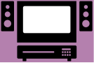




Application Sectors
INDUSTRIAL & COMMERCIAL
CONSUMER ELECTRONICS
monitors
sensors
automation
control
TV
VCR
DVD/CD
remote
PERSONAL HEALTH CARE
PC & PERIPHERALS
ZigBee
LOW DATA-RATE
RADIO DEVICES
TOYS &
GAMES
HOME AUTOMATION
consoles portables
educational
security
HVAC
lighting
closures
Heating, Ventilation and Air Conditioning systems(HVAC)

Slide 13
Released Specifications
ZigBee Home Automation
ZigBee Smart Energy 3.0
ZigBee Telecommunication Services
ZigBee Health Care
ZigBee Remote Control

Slide 14
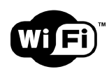
Why NOT 802.11 ? The Cost of Throughput
High data rates
up to 11Mbps for b and
up to 54Mbps for g and a)
Distance up to 300 feet, or more with special antennas
High power consumption
Sources about 1800mA when transceiver is operational.

Slide 15
ZigBee Aims Low
Low data rate
Low power consumption
Small packet devices

Slide 16
What Does ZigBee Do?
Designed for wireless controls and sensors
Operates in Personal Area Networks (PAN’s) and device-to-device networks
Connectivity between small packet devices
Control of lights, switches, thermostats, appliances, etc.

Slide 17
How ZigBee Works
Topology
Star
Cluster Tree
Mesh
Network coordinator, routers, end devices

Slide 18
How ZigBee Works
States of operation
Active
Sleep
Devices
Full Function Devices (FFD’s)
Reduced Function Devices (RFD’s)
Modes of operation
Beacon
Non-beacon

Slide 19
Device types
There are three different types of ZigBee devices:
ZigBee coordinator (ZC): The most capable device, the coordinator forms the root of the network tree and might bridge to other networks. There is exactly one ZigBee coordinator in each network since it is the device that started the network originally. It is able to store information about the network, including acting as the Trust Centre & repository for security keys.
ZigBee Router (ZR): As well as running an application function, a router can act as an intermediate router, passing on data from other devices.
ZigBee End Device (ZED): Contains just enough functionality to talk to the parent node (either the coordinator or a router); it cannot relay data from other devices. This relationship allows the node to be asleep a significant amount of the time thereby giving long battery life. A ZED requires the least amount of memory, and therefore can be less expensive to manufacture than a ZR or ZC.

Slide 20
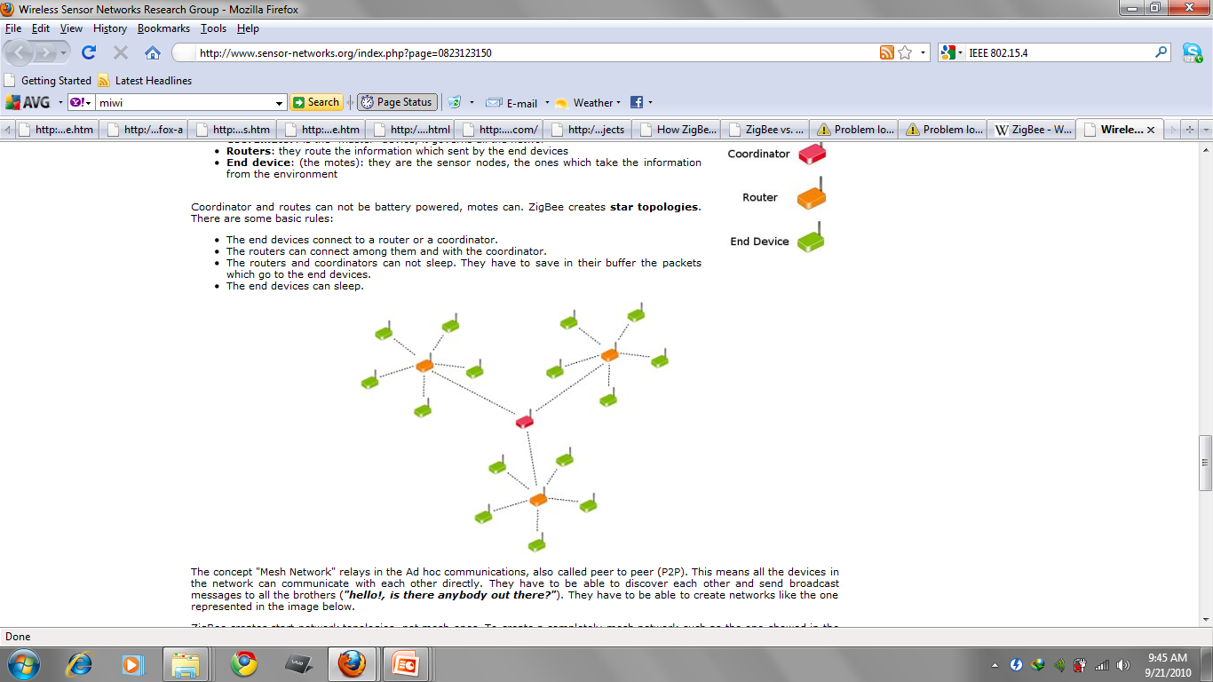

Slide 21
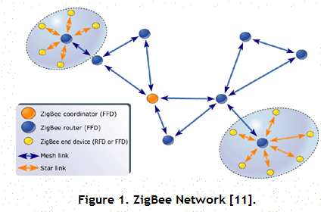
Topology

Slide 22
In beacon-enabled networks, the special network nodes called ZigBee Routers transmit periodic beacons to confirm their presence to other network nodes. Nodes may sleep between beacons, thus lowering their duty cycle and extending their battery life.
In non-beacon-enabled networks, an unslotted CSMA/CA channel access mechanism is used. In this type of network, ZigBee Routers typically have their receivers continuously active, requiring a more robust power supply.
Because ZigBee can activate (go from sleep to active mode) in 15 msec or less, the latency can be very low and devices can be very responsive — particularly compared to Bluetooth wake-up delays, which are typically around three seconds. Because ZigBees can sleep most of the time, average power consumption can be very low, resulting in long battery life.

Slide 23
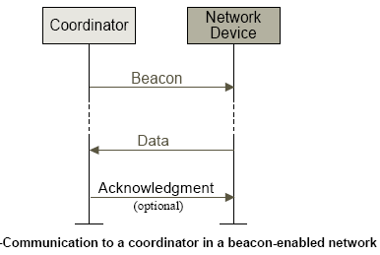
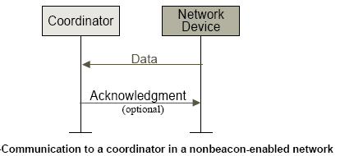
Communication Mechanisms-I

Slide 24
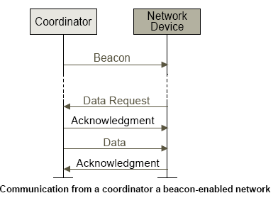
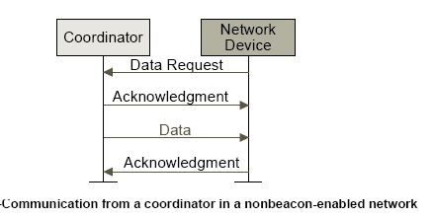
Communication Mechanisms-II

Slide 25
In this mode, the network coordinator will periodically "wake-up" and send out a beacon to the devices within its network. This beacon subsequently wakes up each device, who must determine if it has any message to receive. If not, the device returns to sleep, as will the network coordinator, once its job is complete.
Non-beacon mode, on the other hand, is less coordinated, as any device can communicate with the coordinator at will. However, this operation can cause different devices within the network to interfere with one another, and the coordinator must always be awake to listen for signals, thus requiring more power.
In any case, ZigBee obtains its overall low power consumption because the majority of network devices are able to remain inactive over long periods of time.

Slide 26
ZigBee Mesh Networking

Slide 27
ZigBee Mesh Networking

Slide 28
ZigBee Mesh Networking

Slide 29
ZigBee Mesh Networking

Slide 30
ZigBee Mesh Networking

Slide 31
ZigBee routing in a mesh network
The route discovery in a ZigBee network is similar to the AODV routing protocol
Links with lower cost will be chosen into the routing path.
The cost of a link is defined based on the packet delivery probability on that link
Route discovery procedure
The source broadcasts a route request packet
Intermediate nodes will rebroadcast route request if
They have routing discovery table capacities
The cost is lower
Otherwise, nodes will relay the request along the tree
The destination will choose the routing path with the lowest cost and then send a route reply

Slide 32
ZigBee routing in a mesh network

Slide 33
IEEE 802.15.4 develops the Medium Access Control (MAC) Layer and Physical (PHY) Layer, which address such things as the frequency and data rate specifications. The Physical Layer also allows for two types of devices: full function devices (FFD's) and reduced function devices (RFD's).
ZigBee, meanwhile, develops the Network Layer and Application Layer, which includes the Applications Support Sublayer, the ZigBee Device Object, and the Security Services.

Slide 34
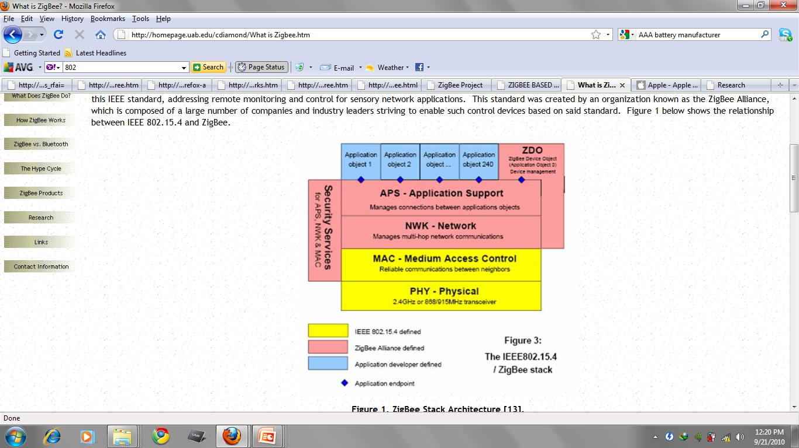

Slide 35

The ZigBee Alliance is a group of companies that maintain and publish the ZigBee standard.

Slide 36










ZigBee Alliance

Slide 37
Development of the Standard
IEEE 802.15.4 Working Group
Defining lower layers of protocol stack: MAC and PHY
Available today
ZigBee Alliance
50+ companies: semiconductor mfrs, IP providers, OEMs, etc.
Defining upper layers of protocol stack: from network to application, including application profiles
Initial draft available mid 2003
APPLICATION
Customer
ZIGBEE STACK
ZigBee
Alliance
SILICON
IEEE

Slide 38
ZigBee Stack Architecture: Addressing
Every device has a unique 64 bit MAC address
Upon association, every device receives a unique 16 bit network address
Only the 16 bit network address is used to route packets within the network
Devices retain their 16 bit address if they disconnect from the network, however, if they leave the network, the 16 bit address is re-assigned

Slide 39
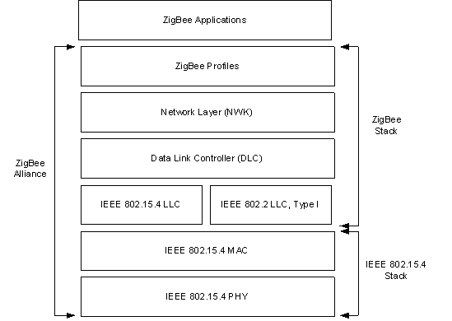
IEEE 802.15.4 and ZigBee Protocol Stack

Slide 40
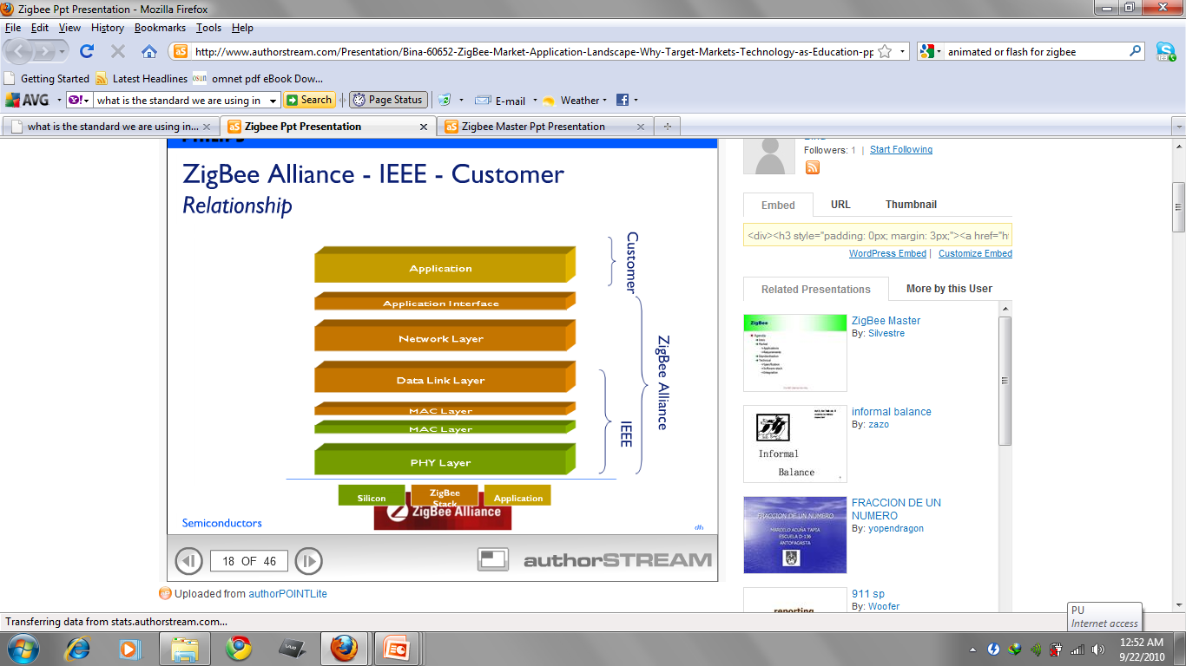

Slide 41
ZigBee: PHY
The radio uses Digital Spread Spectrum Signaling (DSSS)
Conventional DSSS for 868MHz and 915MHz bands
Orthogonal Signaling (4 bits per symbol) for 2.4GHz band
Number of channels
16 channels in the 2.4GHz ISM band
10 channels in the 915MHz
one channel in the 868MHz

Slide 42
ZigBee: MAC
Employs 64-bit IEEE & 16-bit short addresses
Three device types specified
Network Coordinator
Full Function Device (FFD)
Reduced Function Device (RFD)
Simple frame structure
Reliable delivery of data
Association/disassociation
AES-128 security
CSMA-CA channel access
Optional Superframe structure with beacons
Optional Guaranteed Time Slot (GTS) mechanism

Slide 43
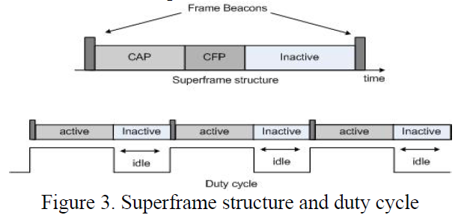
Superframe structure and duty cycle
An active portion can be divided into the CAP(Contention Access Period) and CFP(Contention Free Period).

Slide 44
Superframe
A superframe is divided into two parts
Inactive: all devices sleep
Active:
Active period will be divided into 16 slots
16 slots can further divided into two parts
Contention access period
Contention free period

Slide 45
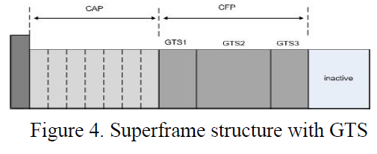

Slide 46
ZigBee as Mesh Networking
ZigBee Coordinator
ZigBee Router/FFD
ZigBee RFD

Slide 47
Network layer (NWK) supports three topologies:
Star
Mesh
Cluster-Tree ( = Star + Mesh)

Slide 48
ZigBee standard defines the Data Link Controller (DLC) layer, Network layer (NWK) and ZigBee profiles. Profiles are an agreement on messages, message formats and processing actions.
There are two types of ZigBee Profiles:
Device Profile: This profile describes how general ZigBee device features are implemented, such as Binding, Device Discovery and Service Discovery.
Application Profile: This profile is application specific and consists of a list of ZigBee Device Descriptions. Each of the descriptions work together to form an application.

Slide 49
Device Addressing
All devices have IEEE addresses
Short addresses can be allocated
Addressing modes:
Network + device identifier (star)
Source/destination identifier (peer-peer)
Source/destination cluster tree + device identifier (cluster tree)

Slide 50
IEEE 802.15.4 Device Definitions
Full function device (FFD)
Any topology
Network coordinator capable
Talks to any other device
Reduced function device (RFD)
Limited to star topology
Cannot become a network coordinator
Talks only to a network coordinator
Very simple implementation

Slide 51
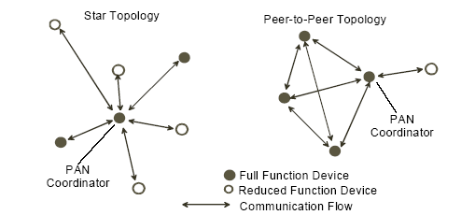
Star and Peer to Peer Networks

Slide 52
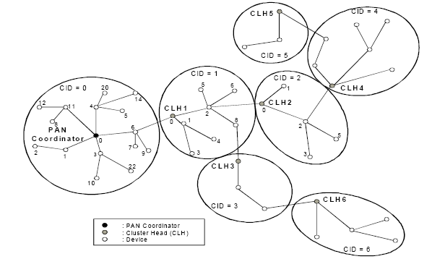
Cluster Tree Network

Slide 53
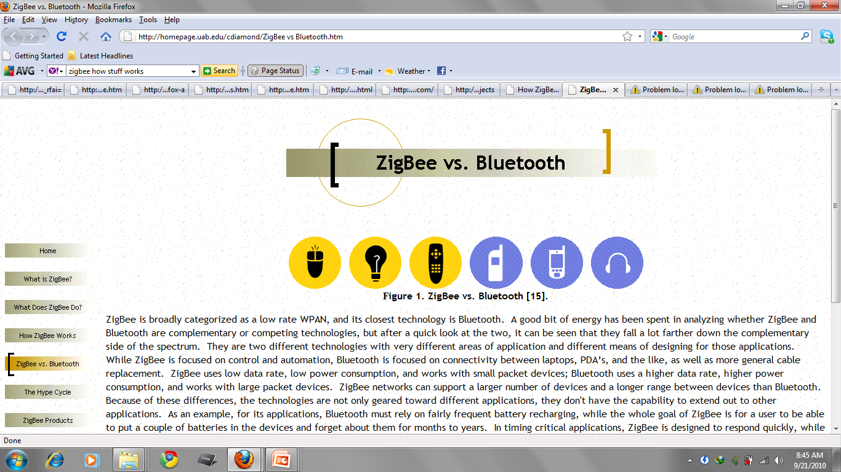
ZigBee is focused on control and automation, Bluetooth is
focused on connectivity between laptops, PDA’s, as well as
more general cable replacement.
ZigBee uses low data rate, low power consumption, and
works with small packet devices; Bluetooth uses a higher
data rate, higher power consumption, and works with large
packet devices.
ZigBee networks can support a larger number of devices
and a longer range between devices than Bluetooth.

Slide 54
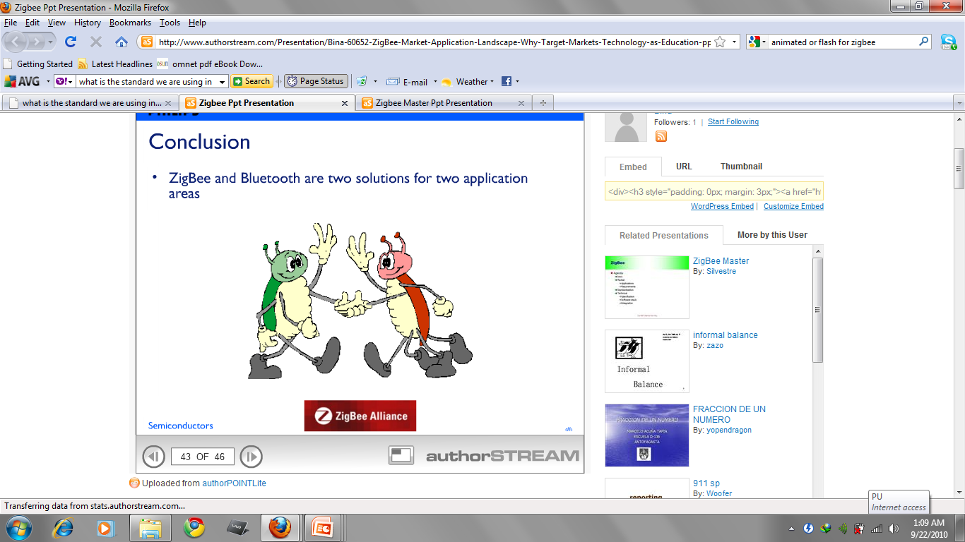

Slide 55
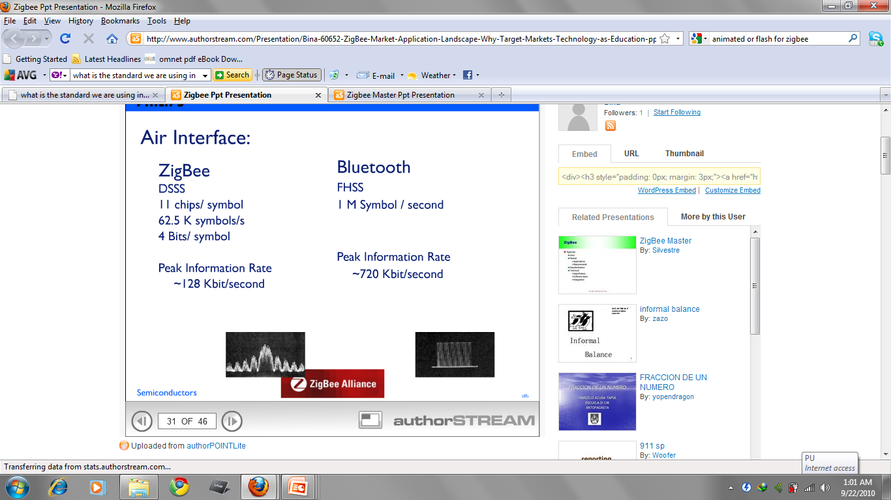

Slide 56
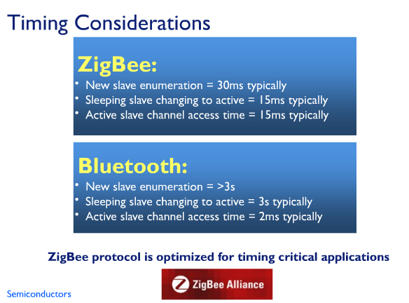

Slide 57
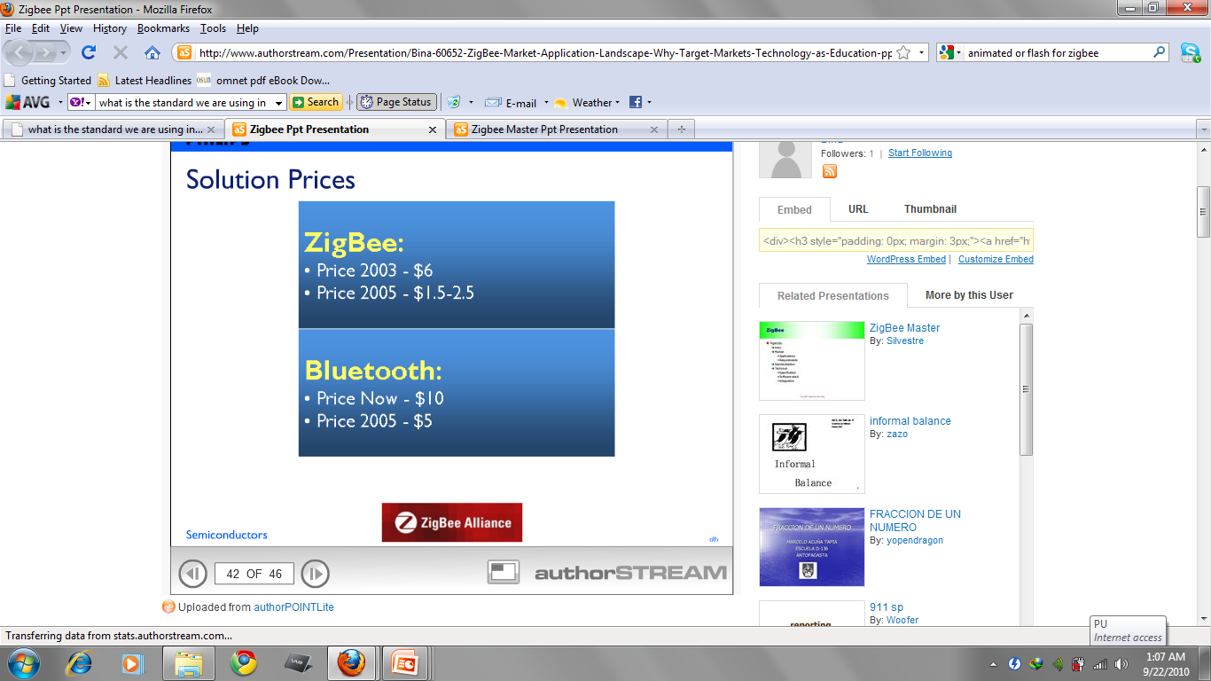

Slide 58
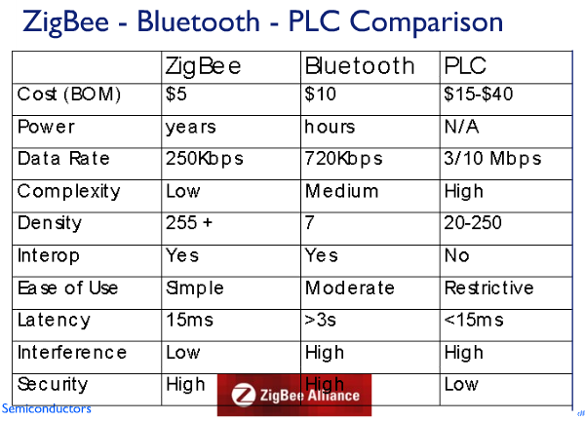

Slide 59
Uses
ZigBee protocols are intended for use in embedded applications requiring low data rates and low power consumption.
ZigBee's current research focuses in defining a general-purpose, inexpensive, self-organizing mesh network that can be used for industrial control, embedded sensing, medical data collection, smoke and intruder warning, building automation, home automation, etc.
Controlling the appliances through mobile phone.

Slide 60
ZigBee Applications
Wireless home security
Remote thermostats for air conditioner
Remote lighting, drape controller
Call button for elderly and disabled
Universal remote controller to TV and radio
Wireless keyboard, mouse and game pads
Wireless smoke, CO detectors
Industrial and building automation and control (lighting, etc.)

Slide 61
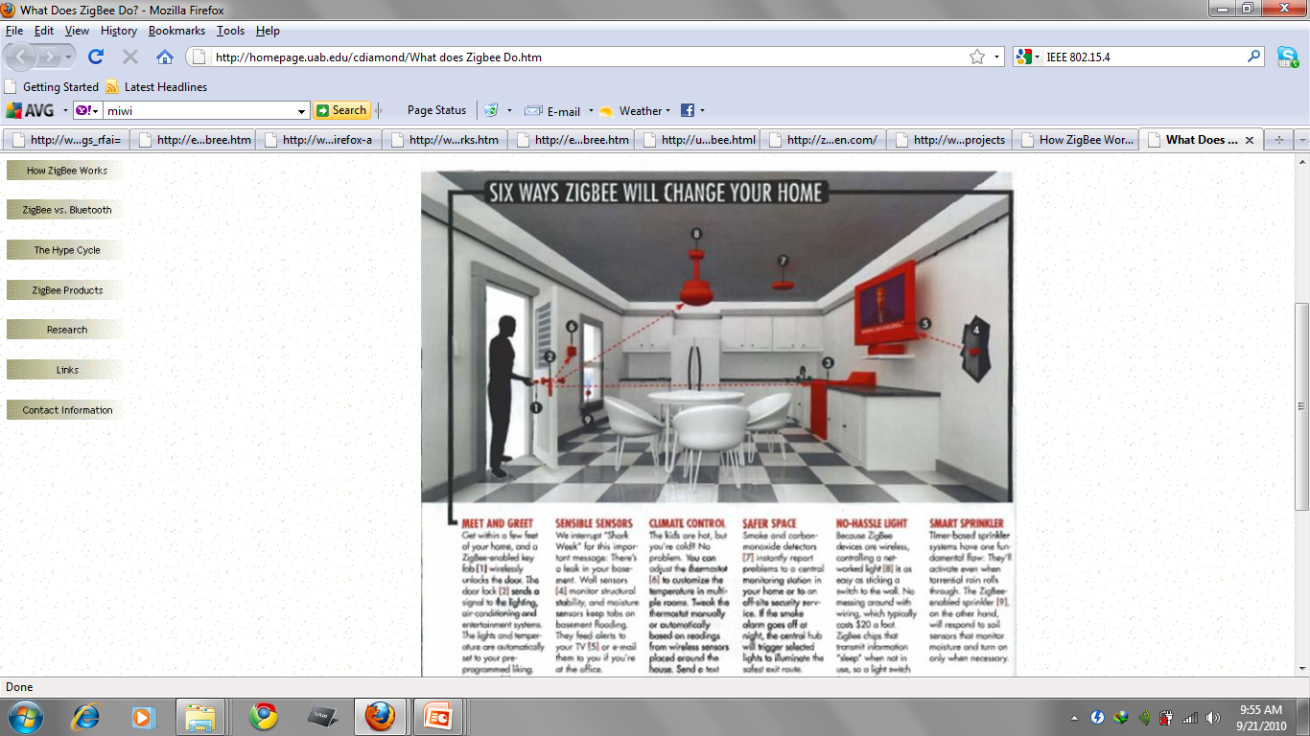

Slide 62
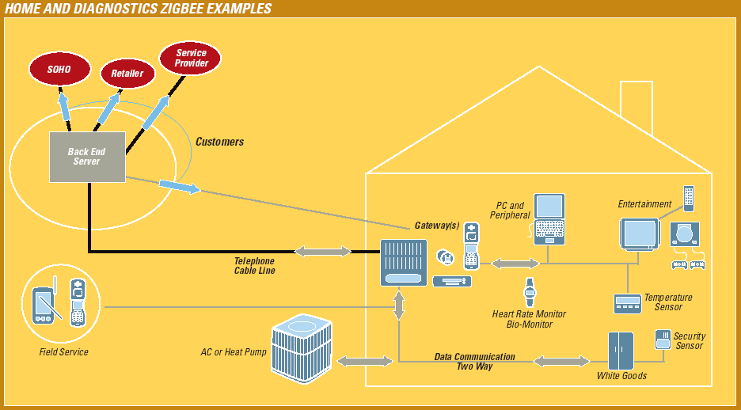

Slide 63
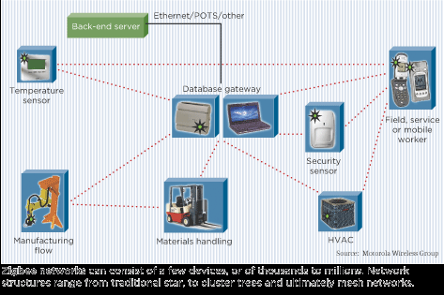
Industrial Environment

Slide 64
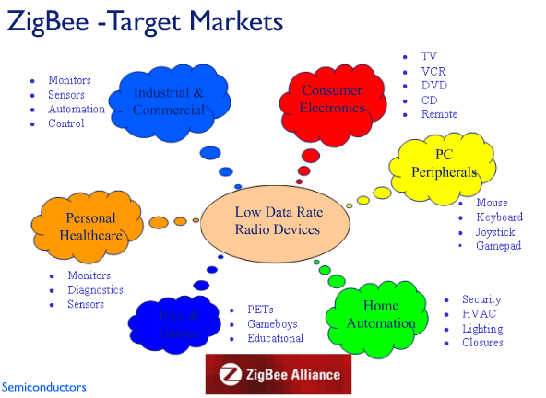

Slide 65
References
http://homepage.uab.edu/cdiamond/How%20Zigbee%20Works.htm
http://zigbee.nectareen.com/?p=23
http://www.authorstream.com/Presentation/Bina-60652-ZigBee-Market-Application-Landscape-Why-Target-Markets-Technology-as-Education-ppt-powerpoint/
http://en.wikipedia.org/wiki/ZigBee
http://www.freescale.com/webapp/sps/site/homepage.jsp?code=802-15-4_HOME
http://www.zigbee.org/About/OurMission.aspx
ZigBee Alliance web site: http://www.ZigBee.org
IEEE 802.15.4 web site: http://www.ieee802.org/15/pub/TG4.html
http://www.prismmodelchecker.org/casestudies/zigbee.php

Slide 66
No Queries!
. .
U

Slide 67
Superframe structure
In order to allow guaranteed time slots for low-latency applications and applications requiring a specific data bandwidth, IEEE 802.15.4 networks can choose to synchronize their communication according to a Superframe structure. Each Superframe consists of 16 equally sized slots and is bounded by network beacons, which are periodically broadcast by a designated coordinator device.
For transmissions of data frames in the contention access period, the slotted mode of the CSMA-CA algorithm is used, while transmissions in the contention free period take place according to pre-assigned guaranteed timeslots. In networks without beacon synchronization, data frames are transmitted using unslotted CSMA-CA.

Slide 68
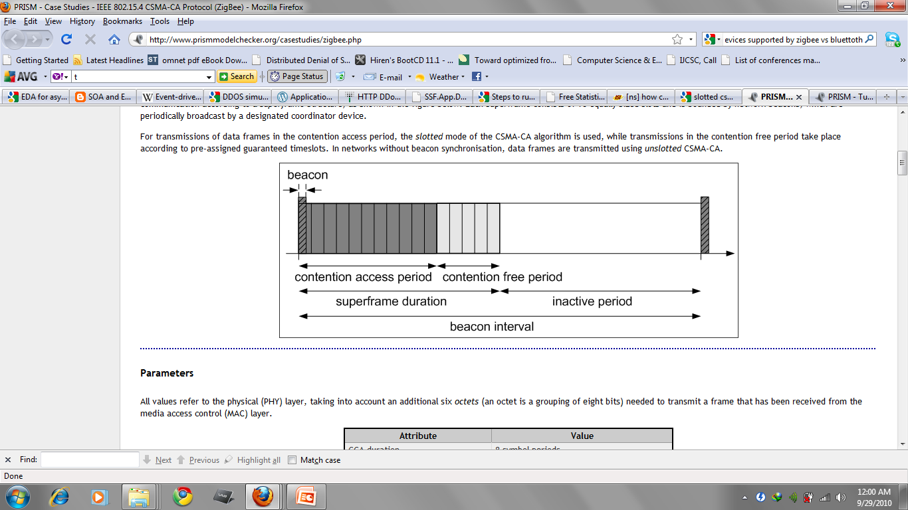

Slide 69
ZigBee as Mesh Networking
ZigBee Coordinator
ZigBee Router/FFD
ZigBee RFD

Slide 70
The mesh networking provides high reliability and more extensive range.
The typical example of a heterogeneous network is a wireless light switch: The ZigBee node at the lamp may receive constantly, since it is connected to the mains supply, while a battery-powered light switch would remain asleep until the switch is thrown. The switch then wakes up, sends a command to the lamp, receives an acknowledgment, and returns to sleep. In such a network the lamp node will be at least a ZigBee Router, if not the ZigBee Coordinator; the switch node is typically a ZigBee End Device.

Slide 71
ZigBee Mesh Networking

Slide 72
ZigBee Mesh Networking

Slide 73
ZigBee Mesh Networking

Slide 74
ZigBee Mesh Networking

Slide 75
ZigBee Mesh Networking

Slide 76
Transmission range is between 10 and 75 meters (33 and 246 feet) and up to 1500 meters for zigbee pro.
More than 200 companies have joined the ZigBee Alliance.
The specified maximum range of operation for ZigBee devices is 250 feet (76m), substantially further than that used by Bluetooth® capable devices.
As ZigBee network supports 65536 devices. With the current stack will it support all 65536 devices. But as a practical matter, the PIC18 will not support 64K devices, because with that many devices on the network, the routing table, neighbor table etc, would not fit on the 64K PIC part.
ZigBee networks will support up to 255 connected devices, for instance, while Wi-Fi supports only 50 before network performance begins to degrade. On the other hand, ZigBee has a range of 30 meters, while Wi-Fi supports a range of 100 meters.

Slide 77
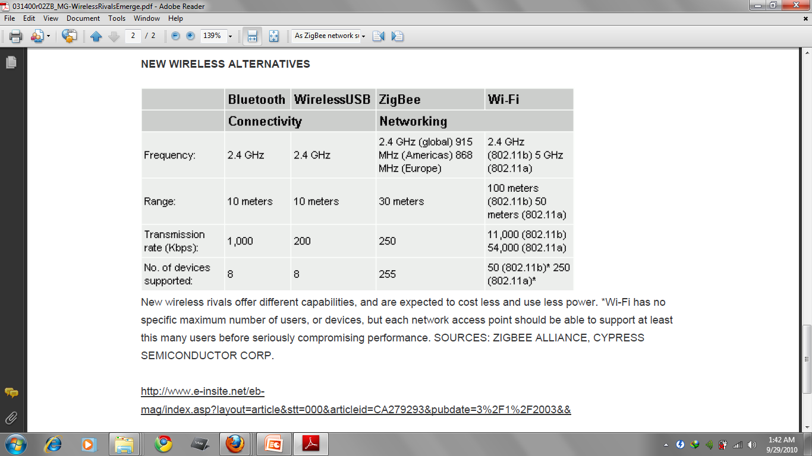

Slide 78
Applications in INDIA
SoilNet - A Zigbee based soil moisture sensor network.
“SoilNet - A Zigbee based soil moisture sensor network” Project Group, Institute Of Chemistry And Dynamics Of The Geosphere (ICG), Agrosphere Institute, Germany.
Honeywell's Indian R&D arm has been working on reference designs for industrial automation, the company's focus area. The Bangalore-based set up has been working on ZigBee since the 1990s.
Another good market appliance in India, is in supermarkets such as Food World and Big Bazaar, which have huge refrigerators for cold storage of food. "ZigBee is used to learn about temperature alterations in cold storage. This information can be used to maintain the quality of food.“
Residential communities in metros will soon have ZigBee meters in each complex. This will eliminate any manual mistakes and improve efficiency of the electricity and water board.

Slide 79
"Toys are the biggest consumers of batteries. The cost of replacing the cells time and again might add up to be much more than the toy's worth. But ZigBee-compliant remote controls make them last longer.
ZigBee’s growth in India is very nascent, but is catching up! In India, the market is more focused on automated metering reading for billing and meter management and to prevent power theft.
REINDEER SYSTEMS PVT LTD [ Manufacturer ], India:
RF Transceiver Module (RDZM-T24FZ) - 2.4 GHz Zigbee
Wireless datalogging system with 4 ext inputs.2.4Ghz Zigbee protocol. with receiver,repeater,software& inbuild temp+%RH sensor....
LINK INTERNATIONAL [ Manufacturer, Trading Company ], India
BLueSiLica TechnoLogies Pvt.Ltd [ Trading Company ]: Light Switch Communication: Power line (PLC).
Shreedutt Technologies Pvt Ltd [ Manufacturer ]: Zigbee Automatic Meter Reading ( Amr ) Solution.

Slide 80
Thank you!

